Slide 1



Company
Portfolio
Revolutionize Your Business With Digito Martech Limited.
#
You Name it
We Digitize it

Slide 2



Elite Business
Solutions
Global Solutions for small and Large Businesses
01.
About Us
Digito Martech Ltd. is a leading Software and IT Solution Company that specializes in providing professional and creative solutions for businesses and individuals. With a team of highly skilled IT professionals, Creative Artists, and Digital Marketeers, Digito Martech Ltd. offers a comprehensive range of services to meet the diverse needs of clients seeking to enhance their projects with stunning visuals.
#
You Name it
We Digitize it

Slide 3






Quality
Services
We provide quality solutions to clients that are designed to meet the specific needs of businesses and are built to high standards.
Content Creation & Design
Dynamic Media & Animation
Social Media
& Digital Outreach
Social Media Post Design, Basic Image Editing, Print Media Design, Brand Identity Design, Art & Illustration, NSFW Art, Comic Book, Typography, Image Manipulation, Product Design.
Motion Video, Logo Animation, VFX Content, Film/Vlog Editing, Music Video Editing, TV Show Editing, Documentary Video Editing, Animation Creation
(2D & 3D)
Social Media Sites Management, Social Media Buying, Social Media Management, Digital Marketing.
Web & App Solutions
SEO & Data Analytics
Info-Tech Consultation
Website Development, E-Commerce Development, UI/UX Design, Web-App Development, Mobile App Development.
SEO, Data Analysis, Keyword Research and Analysis, Competitor Analysis.
IT Strategy Consulting, IT Project Management, Technology Assessment and Road mapping.
#
You Name it
We Digitize it

Slide 4





Content Creation
& Design
Social Media Post Design Basic Image Editing
Print Media Design
Brand Identity Design
Art & Illustration
NSFW Art
Comic Book
Typography
Image Manipulation
Product Design
#
You Name it
We Digitize it

Slide 5

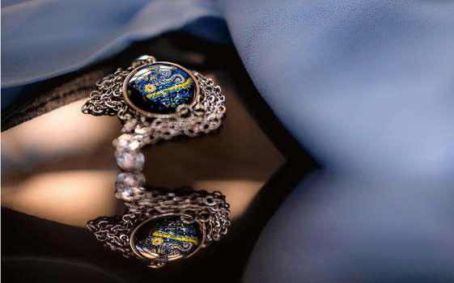


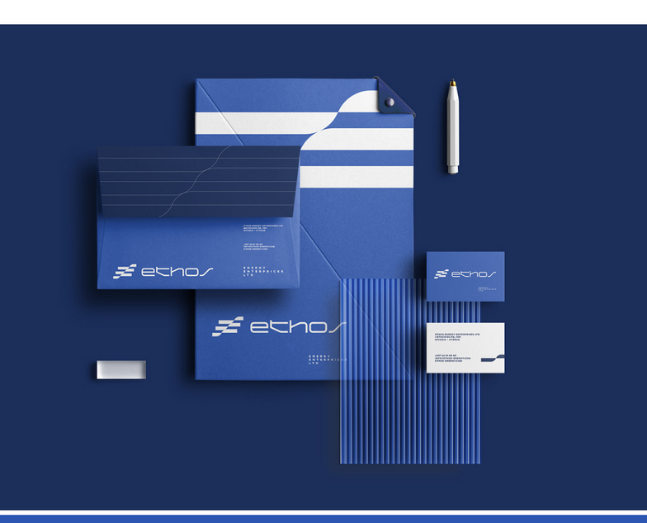





Content Creation
& Design
#
You Name it
We Digitize it

Slide 6
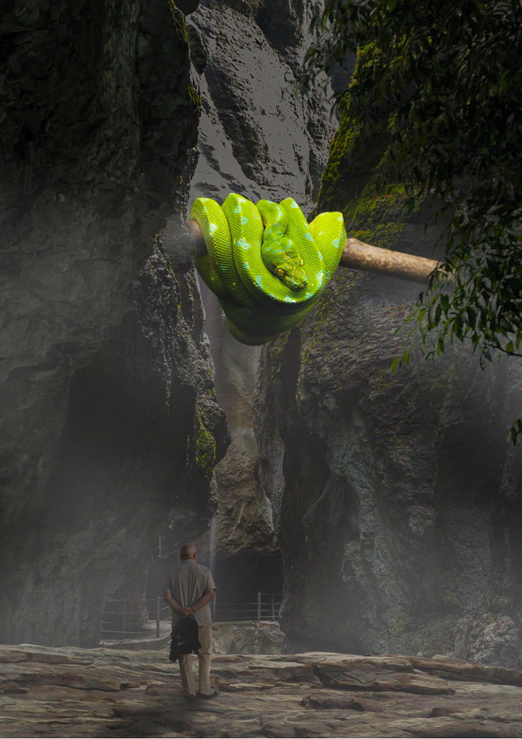
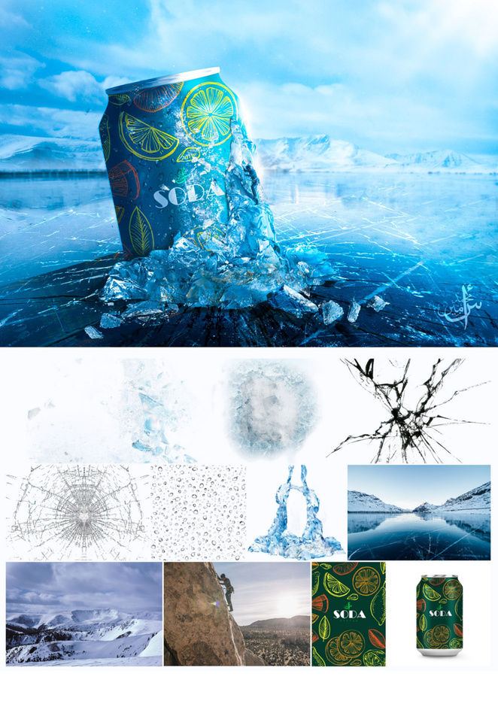
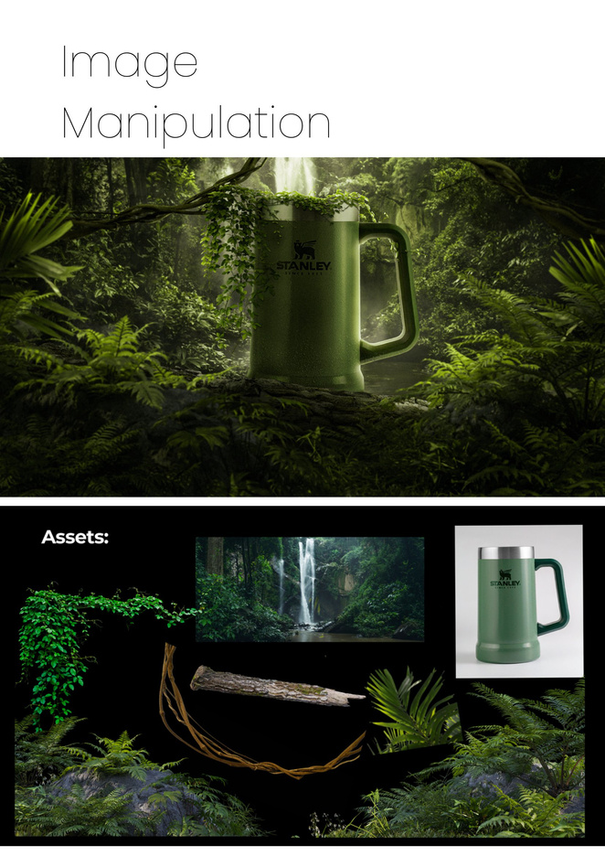
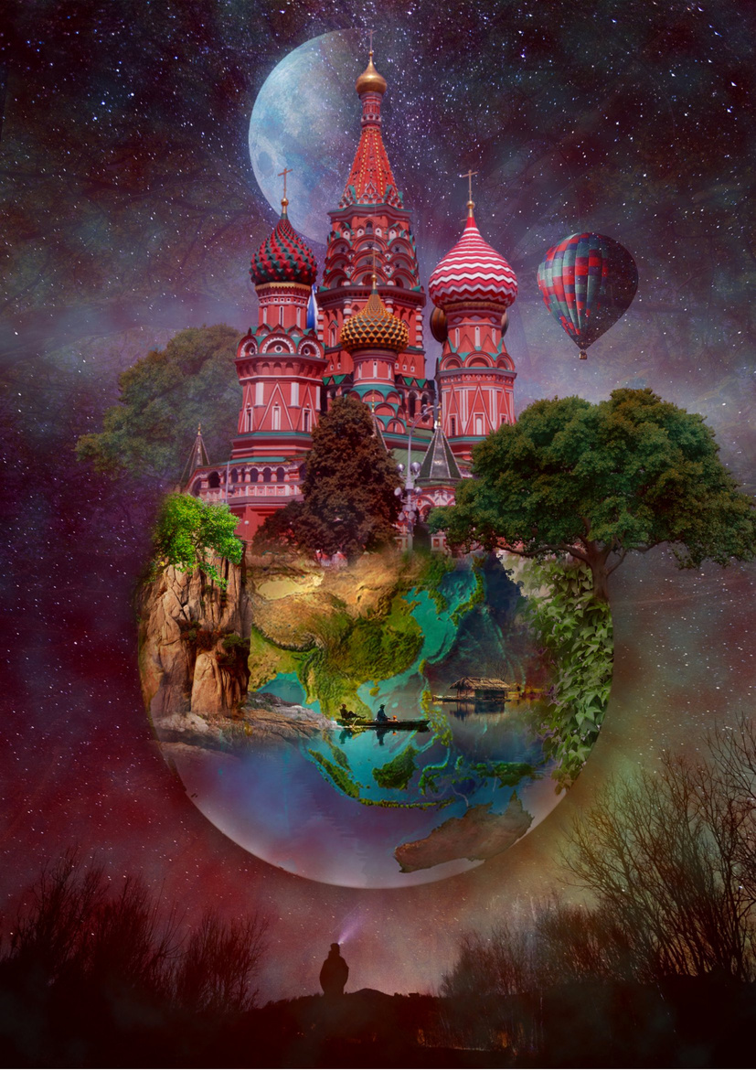

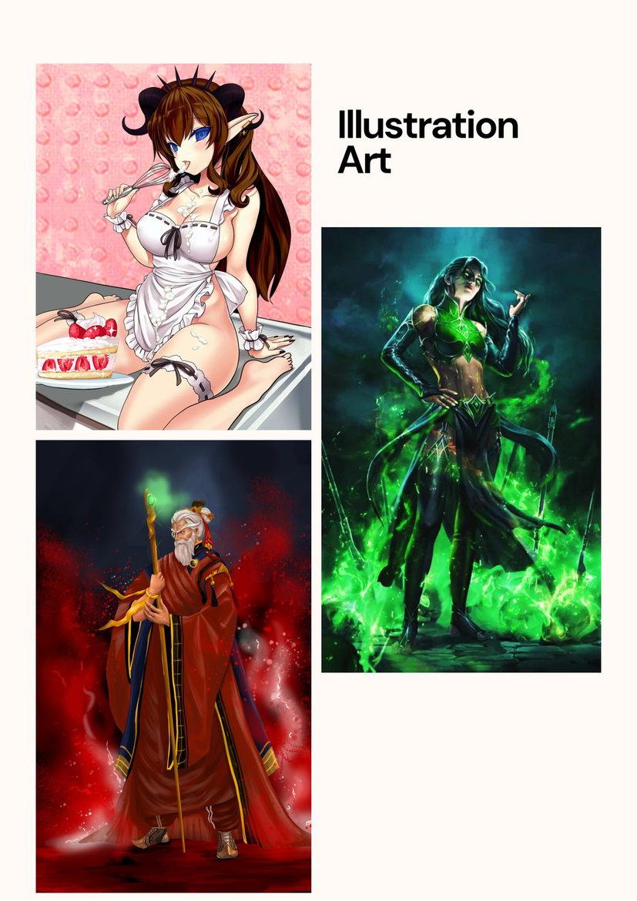

Content Creation
& Design
#
You Name it
We Digitize it

Slide 7

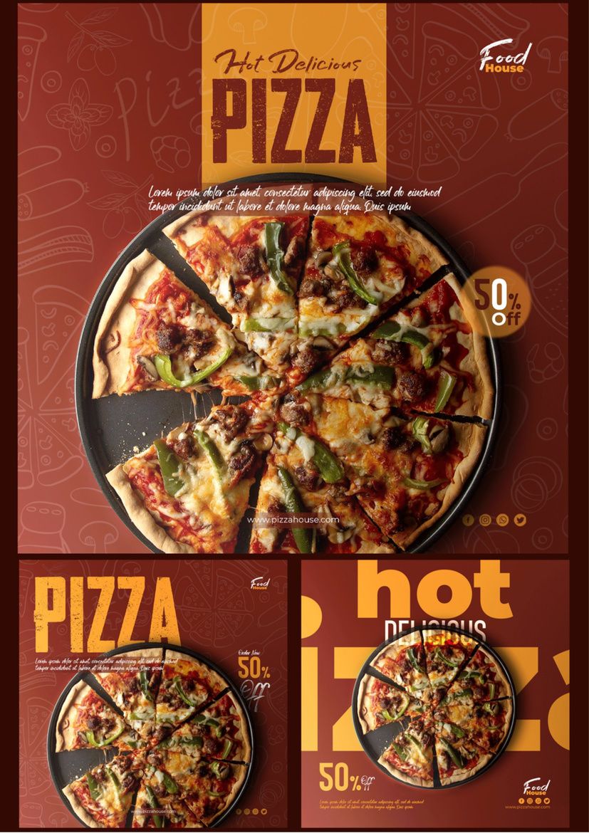

Content Creation
& Design

Slide 8
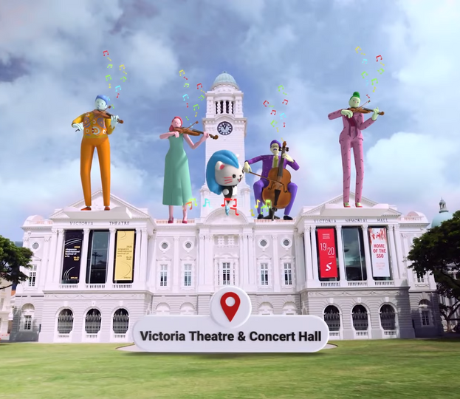
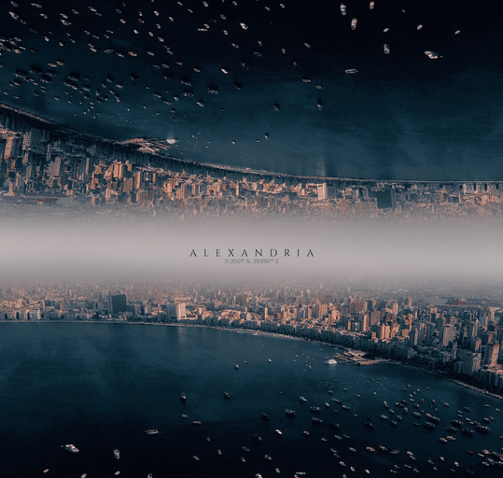

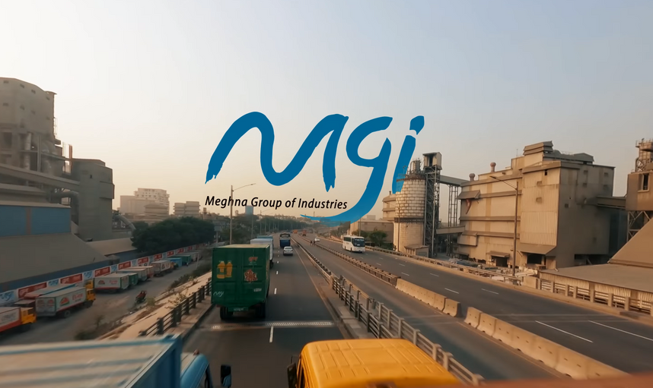
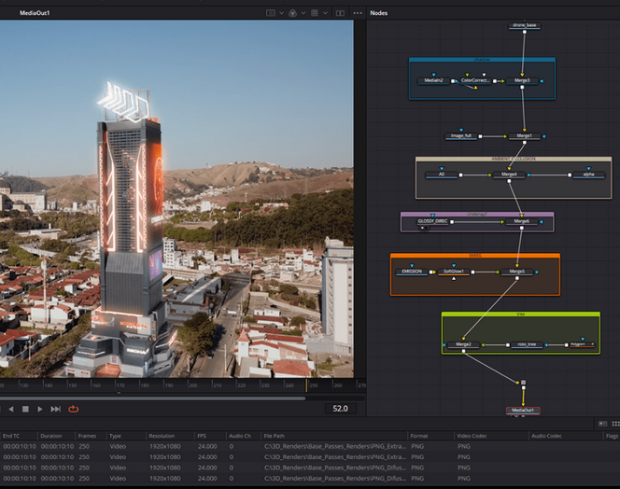
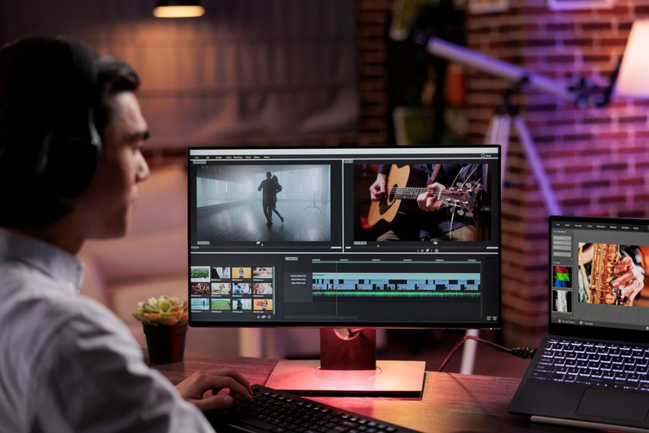
Dynamic Media
& Animation
Motion Video
Logo Animation
VFX Content
Film/Vlog Editing
Music Video Editing
TV Show Editing
Documentary Video Editing
Animation Creation (2D & 3D)
#
You Name it
We Digitize it

Slide 9
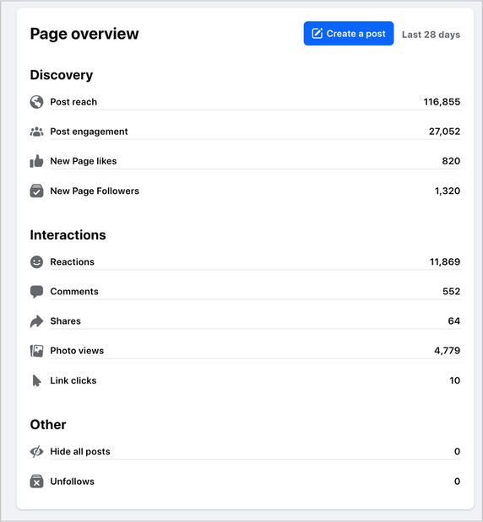
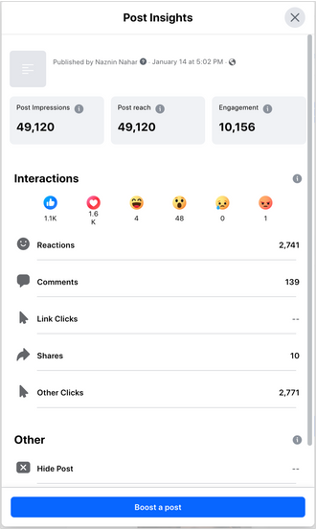
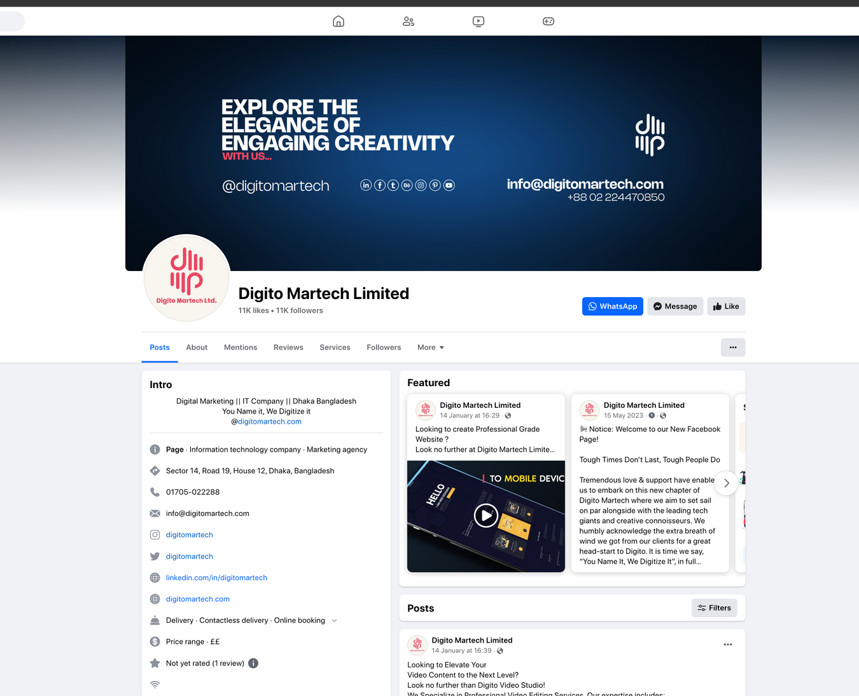
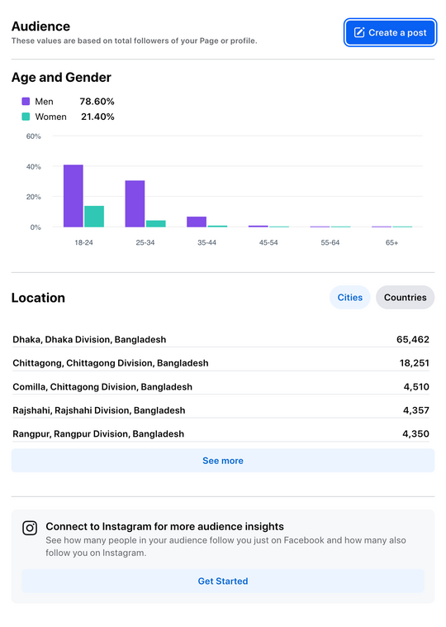
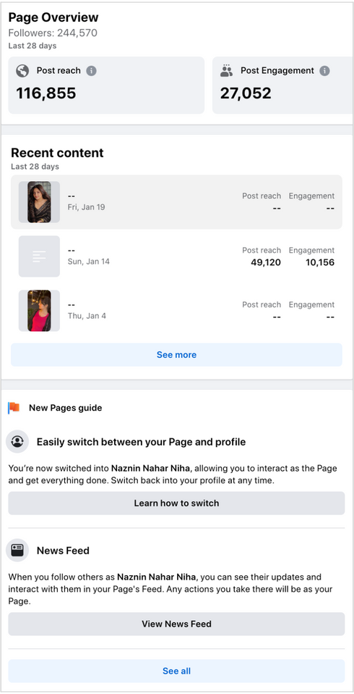
Social Media
& Digital Outreach
Social Media Sites Management
Social Media Buying
Social Media Management
Digital Marketing
#
You Name it
We Digitize it

Slide 10
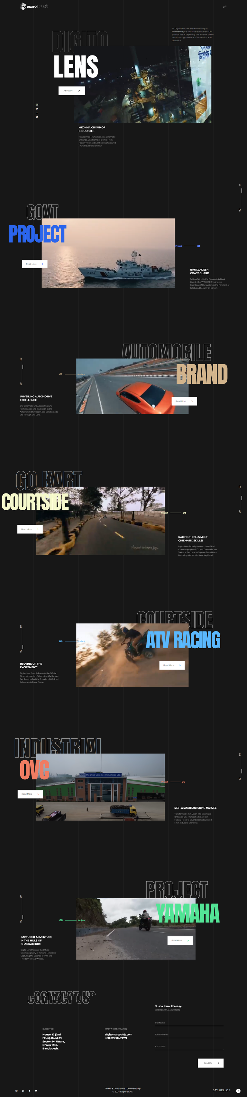
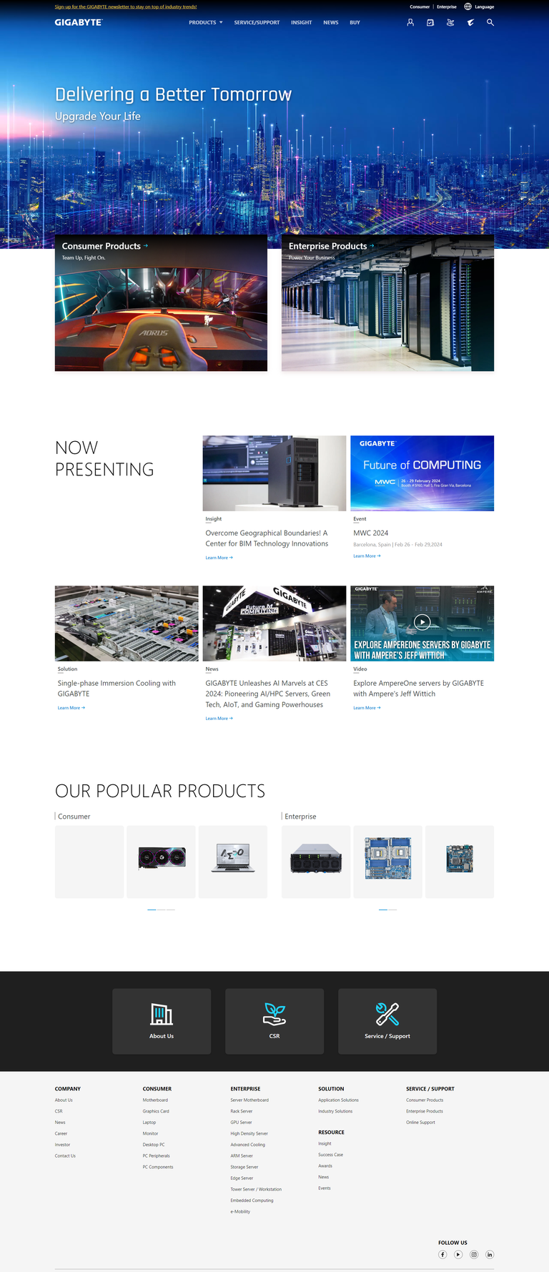
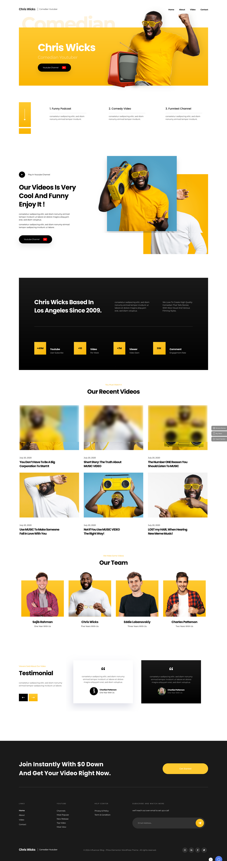
Web
& App Solution
Website Development
E-Commerce Development
UI/UX Design
Web-App Development
Mobile App Development
#
You Name it
We Digitize it

Slide 11
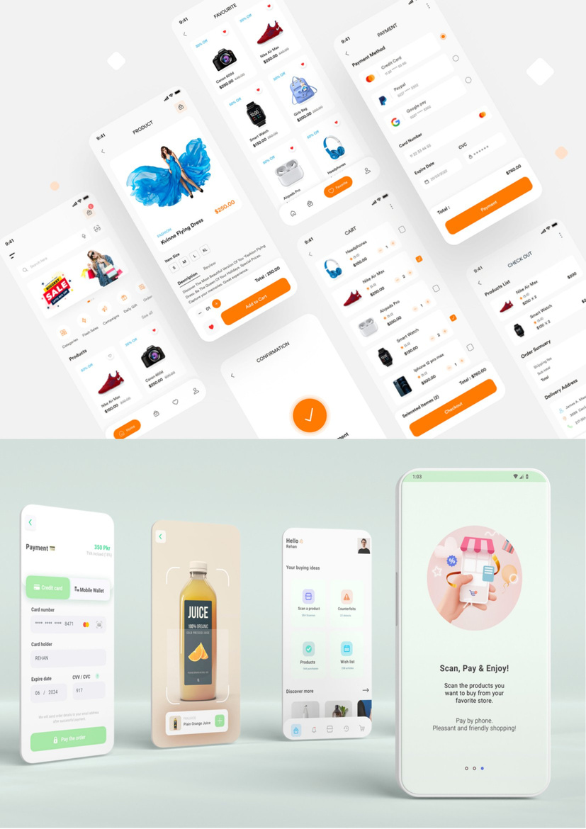
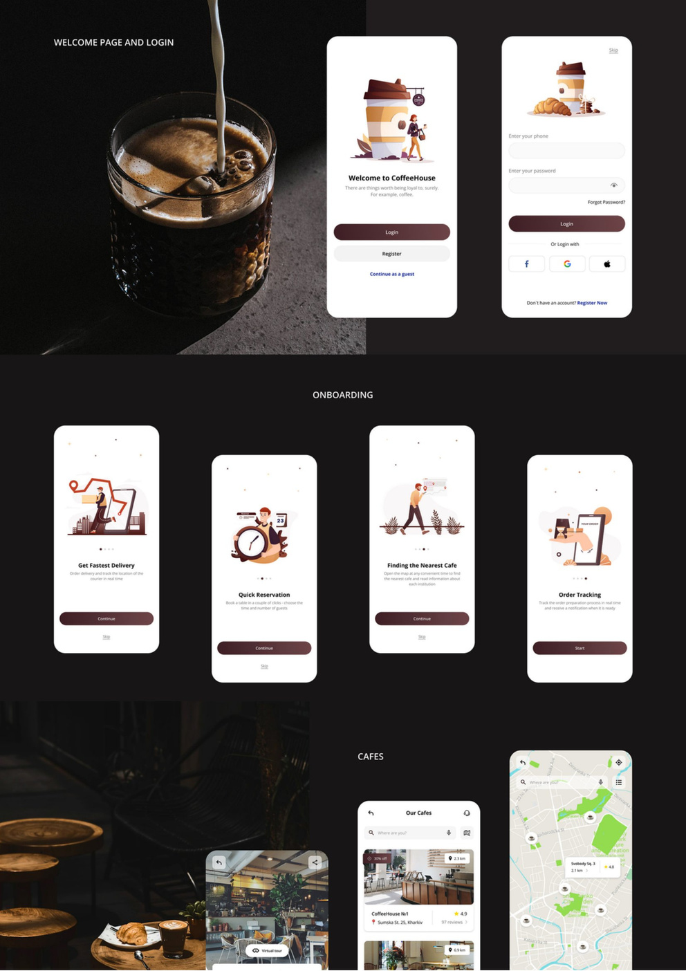
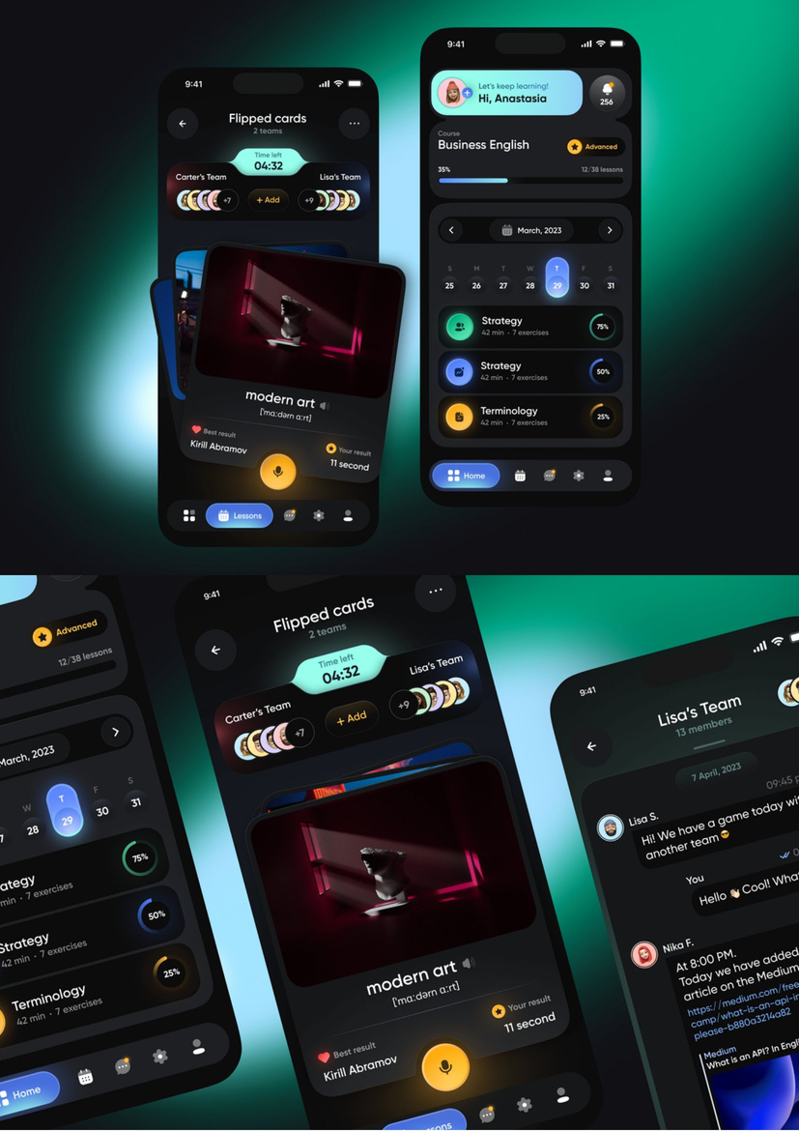
Web
& App Solution
#
You Name it
We Digitize it

Slide 12
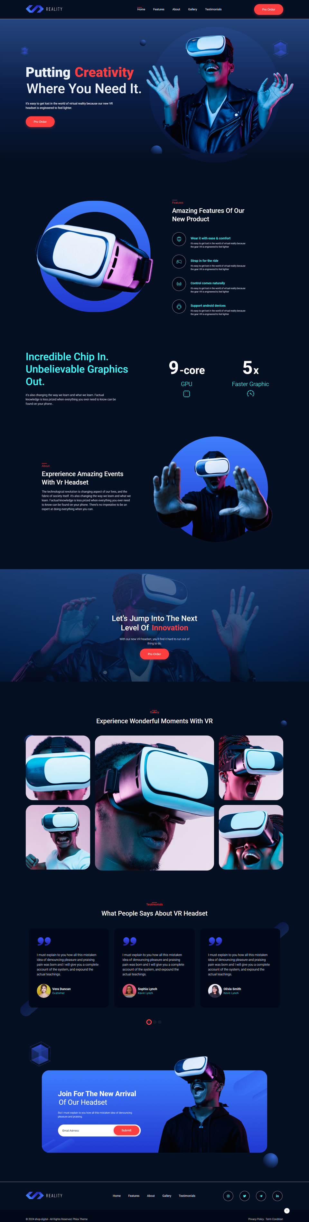
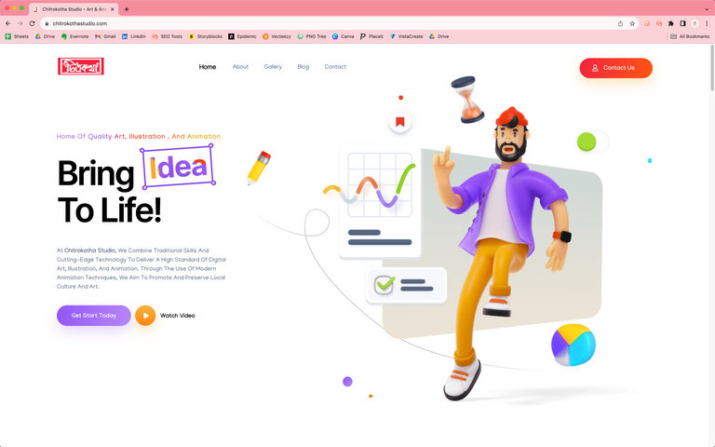
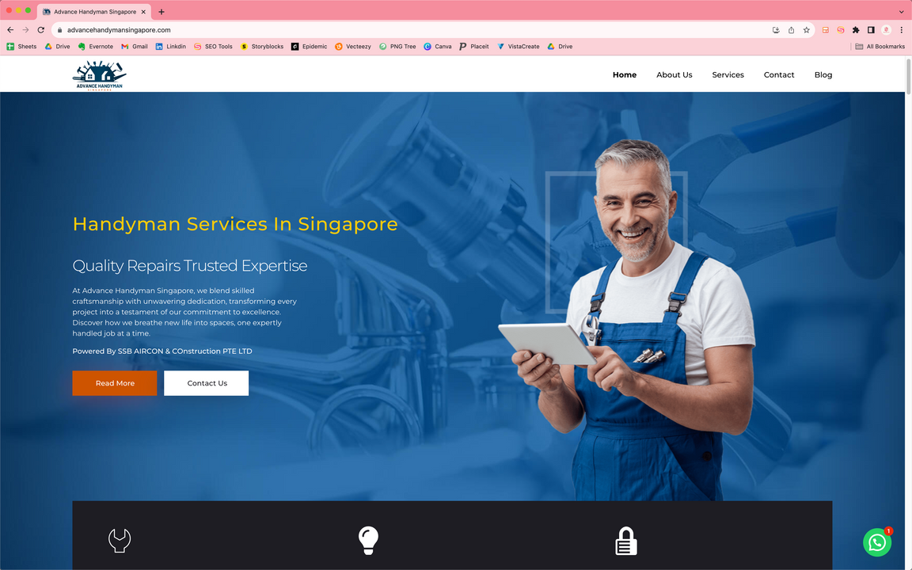
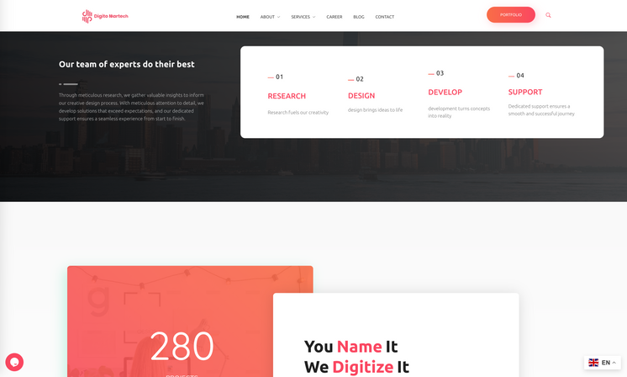
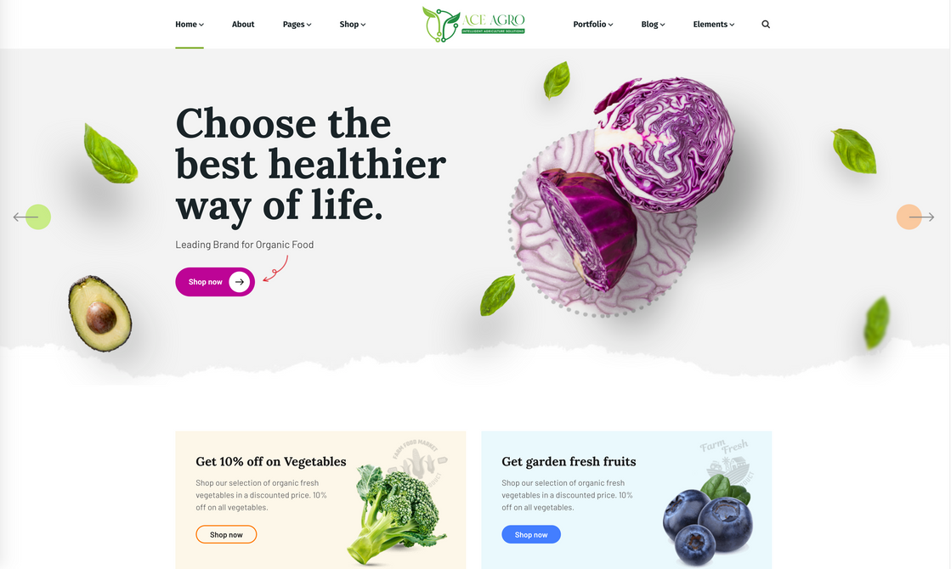
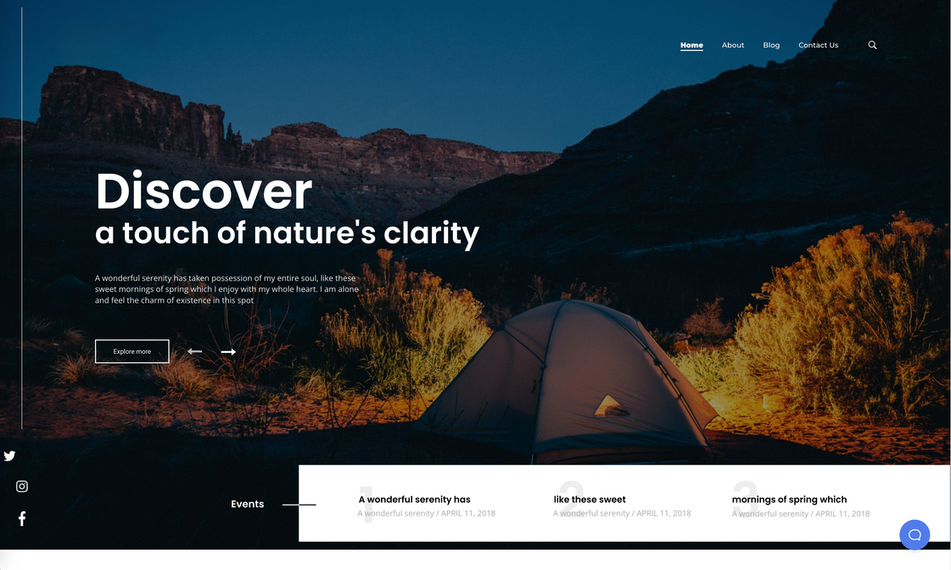
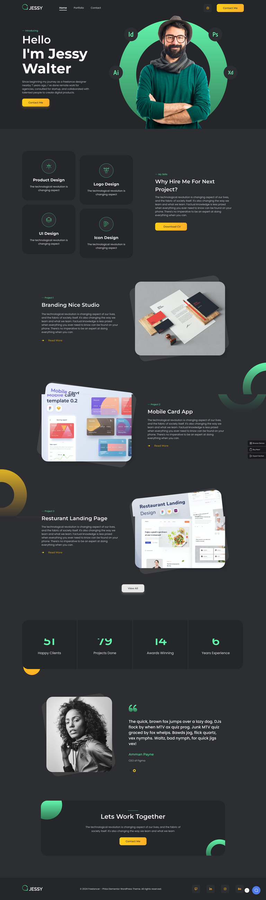
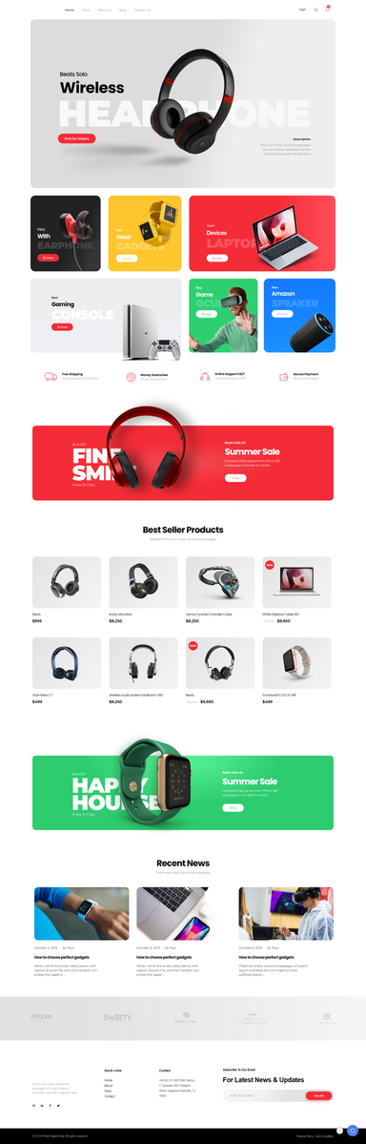
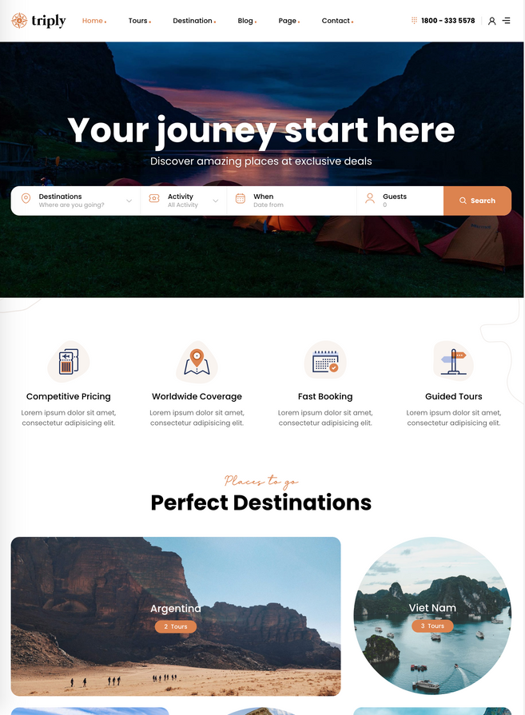
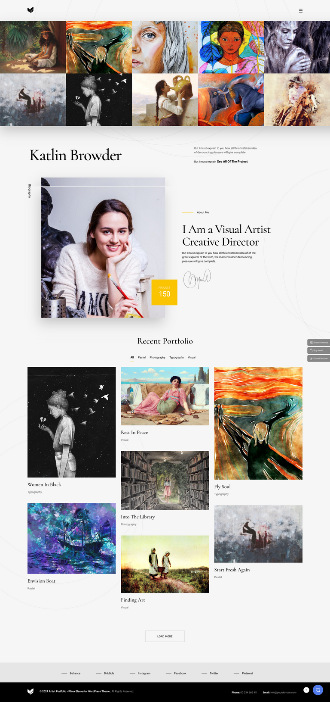

Web
& App Solution
#
You Name it
We Digitize it

Slide 13



SEO
& Data Analytics
SEO
Data Analysis
Keyword Research and Analysis
Competitor Analysis
#
You Name it
We Digitize it

Slide 14



Info-Tech Consultation
IT Strategy Consulting
IT Project Management
Technology Assessment
Road mapping
#
You Name it
We Digitize it

Slide 15





































Our
Clients
TINDS
#
You Name it
We Digitize it

Slide 16





Contact
PHONE
E-MAIL
+880 1748 15-8502
digitomartech.cumilla@gmail.com
WEBSITE
SOCIAL MEDIA
Revolutionize Your Business With Digito Martech Limited.
www.digitomartech.com
@digitomartech
@digitomartech
#
You Name it
We Digitize it

